Slide 1
Heart Disease Prediction using Machine Learning
Proposed by
Eda Sai Akhil - 700747481
Stuthi Geetha Muppalla– 700745858
Konyala Sai vardhan reddy– 700745733
Maddina Mythresh- 700741162

Slide 2
Group Member Information
Sai Vardhan Reddy - 700745733
Mythresh Maddina -700741162
Eda Sai Akhil - 700747481
Stuthi Geetha Muppala - 700745858

Slide 3
Role/Responsibilities and Contribution in Project
Name | Responsibilities
Sai Vardhan Reddy | Flow chart for the project is created and distributed the tasks to each member and analysis of data and implemented ml models.
Mythresh Maddina | Collection of data from the UCI repository and data is cleaned and selection of features and checking the performance on different models
Sai Akhil | Analysis of data on models basically Ml algorithms and helped in selection of features.
Stuthi Geetha | Study of different ml algorithms and libraries, tools that need to be used.

Slide 4
MOTIVATION
Heart disease: As per survey 17 million deaths occur due to cardiovascular diseases.
Detecting them in the early stages will decrease risk or possibility of the proper cure to the people.
Many factors may be the cause for occurring these diseases which requires an expert analysis and high technology equipment which is expensive.
Using Machine learning algorithms in this field make us job easier to find complex calculation and predict the output.
This driven us to find the efficient solution or model that helps in predicting the heart disease possibility in the early stages with more accuracy.

Slide 5
Objective
Since, the detection of heart disease is difficult using traditional methods we are will use the machine learning techniques to solve the problem.
In order to achieve the goal we will study the different classification, regression algorithms.
Obtain the dataset that has large amount useful data and from UCI repository is taken since most of the researchers used this data developing the basic model of Heart disease prediction.
Study of hybrid models is done and analyze the change in the accuracy with different combination and one is implemented.

Slide 6
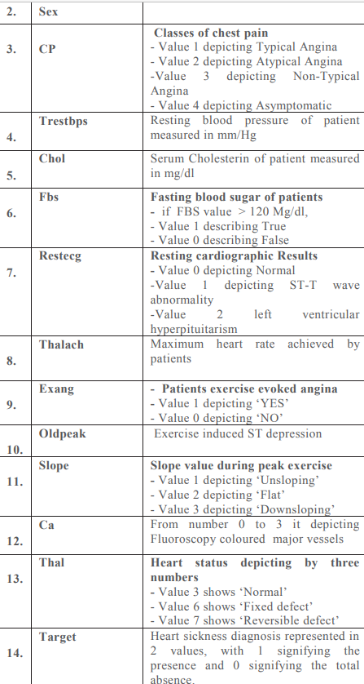
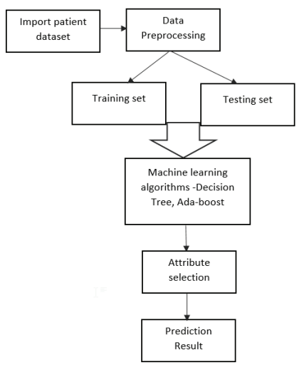
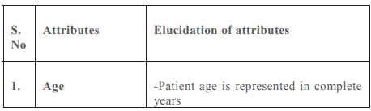
Related Work PAPER-1
The dataset used here contains 14 attributes and the independent variable that needs to be predicted is 'target', which determines whether a person is healthy 3 or suffers from heart disease.
There are various machine learning algorithms that can be used for heart disease prediction. These include supervised learning algorithms such as decision trees and Ada-boost algorithms.

Slide 7
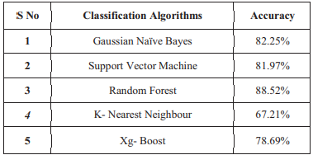
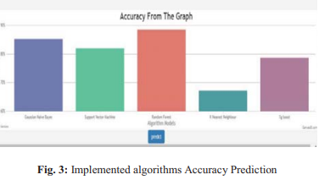
PAPER-2
Heart disease is the leading problem and one of the biggest causes for no. of deaths happening all over the world.
Heart disease is the leading problem and one of the biggest causes for no. of deaths happening all over the world. In this paper, an effective Heart Disease Prediction framework is implemented using algorithms in Machine Learning such as Gaussian Naïve Bayes, Random Forest, K-Nearest Neighbour, Support Vector Machine, Xg- Boost.

Slide 8
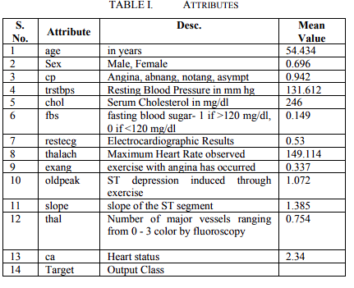
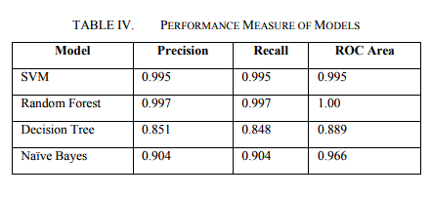
PAPER-3
In this research paper we are using we are using four models SVM,Decision Tree,Naive bayes,Random Forest Classification.
From the dataset we are selecting 14 attributes from total attributes
Since the dataset is having missing values we are replacing the mean values with the missing values. Performance metrics are given by roc,precision,recall,accuracy.
The performance measure shows that random forest shows the highest performance when compared to other models.
Methodology is given by:
1.Data collection
2.Data preprocessing
3.Building model
4.Accuracy measurement of Model

Slide 9
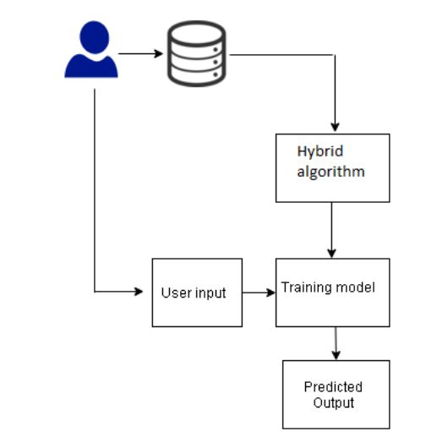
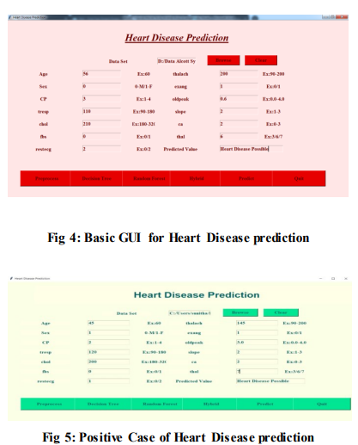
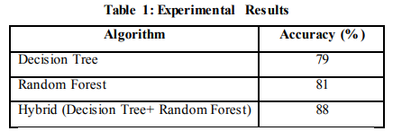
PAPER-4
Here the dataset present at UCI of cleveland.data is given to the Decision tree , Random Forest and Hybrid model.
The detail comparison of the models are provided.
The block diagram of the existing model is shown here.
Output:

Slide 10
Problem Statement
Heart diseases such as coronary artery, cardiac attack results in deaths irrespective of age and detection them in the earlier is critical task.The risk getting attack by these diseases is high in person who have high cholesterol or lack of physical activity.
By using machine learning we can solve critical problems by training the model available from kaggle or UCI Irvine and make model to able to predict the health condition of the person by considering some of the important parameter such as age, heart rate, ecg o/p, type of chest pain etc..

Slide 11
Proposed Solution
According to multiple polls, heart disease is one of the major causes of death around the globe, regardless of a person's gender. The healthcare industry generates a large amount of data; thus it is necessary to process this data using any cutting-edge methods that will help us produce efficient outcomes, make efficient decisions based on the data, and obtain the desired outcomes.
The research paper has suggested the combined use of the decision tree and random forest to improvise the accuracy of the model given the input and this hybrid model gave us the highest accuracy.
The highest accuracy was given by hybrid model of 88% (decision tree+random forest)

Slide 12
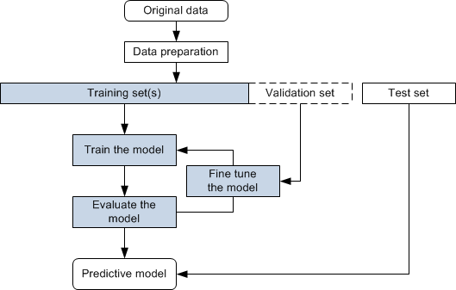

Slide 13
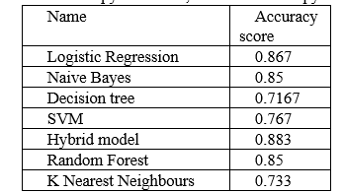
Results/Simulations
Here the data is trained using different ML algorithms.

Slide 14
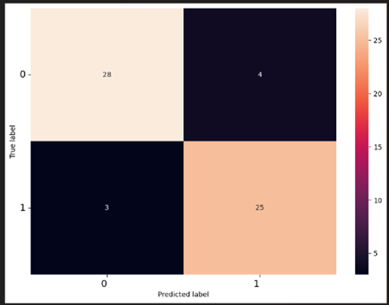
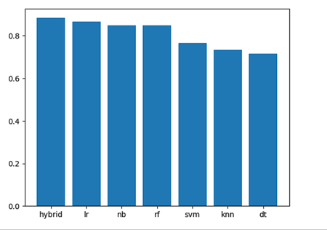
Confusion matrix for Hybrid Model Comparison of Accuracies

Slide 15
REFERENCES
V. Sharma, S. Yadav and M. Gupta, "Heart Disease Prediction using Machine Learning Techniques," 2020 2nd International Conference on Advances in Computing, Communication Control and Networking (ICACCCN), Greater Noida, India, 2020, pp. 177-181, doi: 10.1109/ICACCCN51052.2020.9362842.
M. Kavitha, G. Gnaneswar, R. Dinesh, Y. R. Sai and R. S. Suraj, "Heart Disease Prediction using Hybrid machine Learning Model," 2021 6th International Conference on Inventive Computation Technologies (ICICT), Coimbatore, India, 2021, pp. 1329-1333, doi: 10.1109/ICICT50816.2021.9358597.
S. Farzana and D. Veeraiah, "Dynamic Heart Disease Prediction using Multi-Machine Learning Techniques," 2020 5th International Conference on Computing, Communication and Security (ICCCS), Patna, India, 2020, pp. 1-5, doi: 10.1109/ICCCS49678.2020.9277165.
G. Choudhary and S. Narayan Singh, "Prediction of Heart Disease using Machine Learning Algorithms," 2020 International Conference on Smart Technologies in Computing, Electrical and Electronics (ICSTCEE), Bengaluru, India, 2020, pp. 197-202, doi: 10.1109/ICSTCEE49637.2020.9276802.

Slide 16
Animesh Hazra, Subrata Kumar Mandal, Amit Gupta, Arkomita Mukherjee and Asmita Mukherjee Heart Disease Diagnosis and Prediction Using Machine Learning and Data Mining Techiniques: A Review, ISSN vol 10, No. 7, pp. 2137- 2159.
Sairabi H.Mujawar, P.R.Devale, “Prediction of Heart Disease using Modified K-means and by using Naïve Bayes”, International Journal of Innovative research in Computer and Communication Engineering, vol.3, October 2015, pp.10265-10273.

